Slide 1
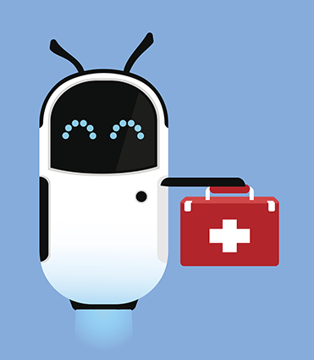
HealthBot: Intelligent Healthcare Assistant using Large Language Models
Ashwin Sateesh Kumar Nikhil Gudipally
Bindu Latha Banisetti Sriram Hariharan Neelakantan

Slide 2
Introduction
Introduction
Intent Classification
HealthBot project addresses the growing demand for accessible healthcare information.
Aim: Develop a sophisticated healthcare assistant to interpret user queries accurately.
Intelligent bot powered by advanced Language Models (LLMs).
Goal: Provide comprehensive and trustworthy advice on user health queries.
Named Entity Recognition(NER)
Contextual Understanding
Health Bot

Slide 3
Component | Purpose | Phase | Techniques & Methods
Intent Classification | Identify user intent in queries | Phase 1 | - Curated labelled dataset
 |  |  | - Word embeddings: BERT
 |  |  | - LSTM with Attention Mechanism
 |  |  | - Accuracy as the performance metric
Named Entity Recognition (NER) | Identify disease, symptoms, and medicine entities | Phase 1 | - Annotated dataset with labelled entities
 |  |  | - BERT
 |  |  | - F1-Score as the evaluation metric
Contextual Understanding | Maintain context in conversation and generate valid responses | Phase 2 | - Data augmentation, cross-validation
 |  |  | - Fine-tune FLAN-T5, GPT models
 |  |  | - Human Feedback and RL

Slide 4
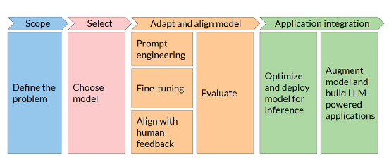
Project Lifecycle
Structure of general LLM based Applications

Slide 5
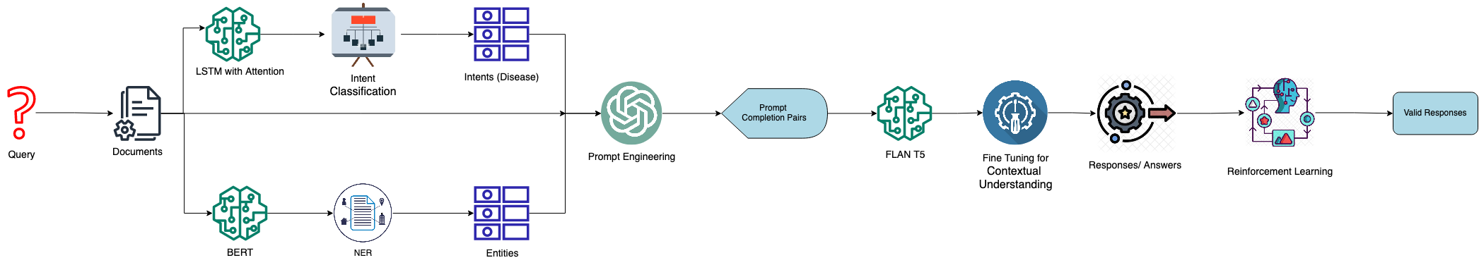
Project Design
Phase 1
Phase 2

Slide 6
Data Description
Intent Classification | Named Entity Recognition | Response Generation
Input: "What are the symptoms of Influenza?” Label: "Influenza" | Input: "I have a persistent cough and fever.” Entities: " persistent ”, “cough”, “fever” Labels: [0,0,0,4,3,0,3] | Input: "What are the medicines of diabetes?” Response: "The medicines for diabetes include: Fiber-containing foods, Antiplatelet medications, Lifestyle changes, Sulfonylureas, Calcium channel blockers, Bismuth subsalicylate supplements.”

Slide 7
Data Preprocessing
Ensured richness and variety in prompt examples by tapping into Hugging Face's extensive resources
The tailored curation of datasets played a crucial role in optimizing the HealthBot's training process, ensuring relevance, accuracy, and adaptability to diverse healthcare queries
Lowercasing ensures uniform treatment of text, avoiding inconsistencies
Tokenization prepares text for structured analysis, enables efficient handling of individual words or tokens in subsequent stages

Slide 8
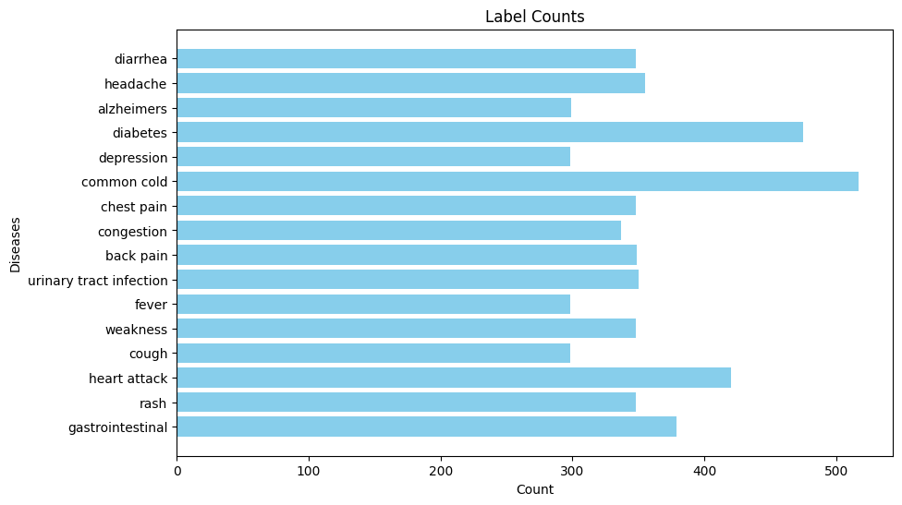
Data Distribution

Slide 9
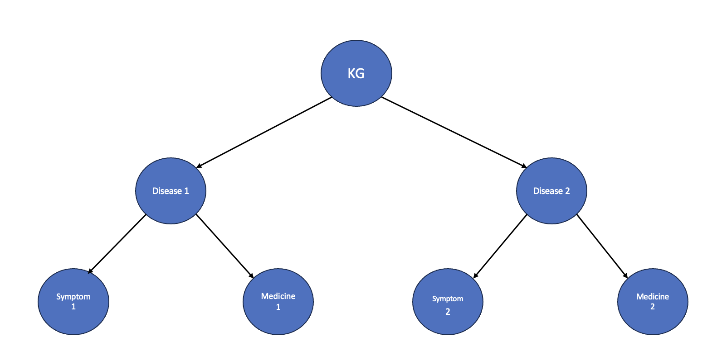
Knowledge Graph
Structured as hierarchical dictionaries, with disease names at the top level, symptoms and medicine within the second level, and their respective names at the lowest level
The detected entities are mapped to the knowledge graph to extract the required information

Slide 10
Prompt Engineering
Prompt engineering involves designing clear and concise instructions in natural language for language models to elicit desired responses or actions
Factors to consider in prompt engineering include clarity, context, and specificity to ensure the model understands and generates relevant outputs
Including examples and conducting testing and iteration to improve response quality and effectiveness
For the context of {disease}, please consider the symptom and medicine information below:
Symptoms for {disease}: {symptom_info} Medicines for {disease}:{medicine_info}
Please provide an answer to the following question:
{question}

Slide 11
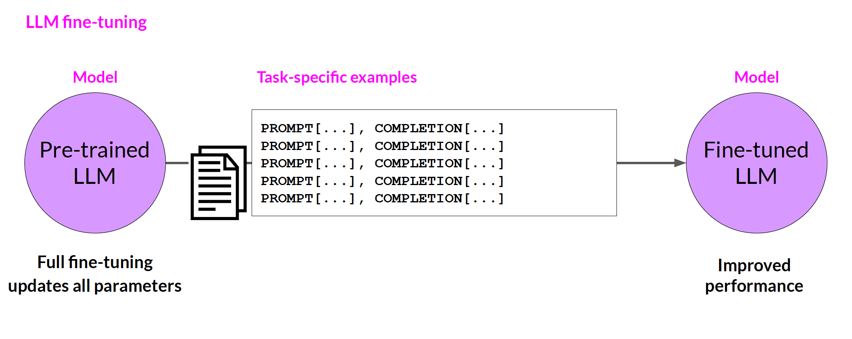
Fine Tuning
Utilize a curated dataset with prompt-completion pairs specific to medical queries
Train the Language Model (LM) for a specific medical domain task – answering user queries
The fine-tuned LLM is specialized for medical query response, offering tailored and accurate information in the healthcare domain
Credits: DeepLearning.AI

Slide 12
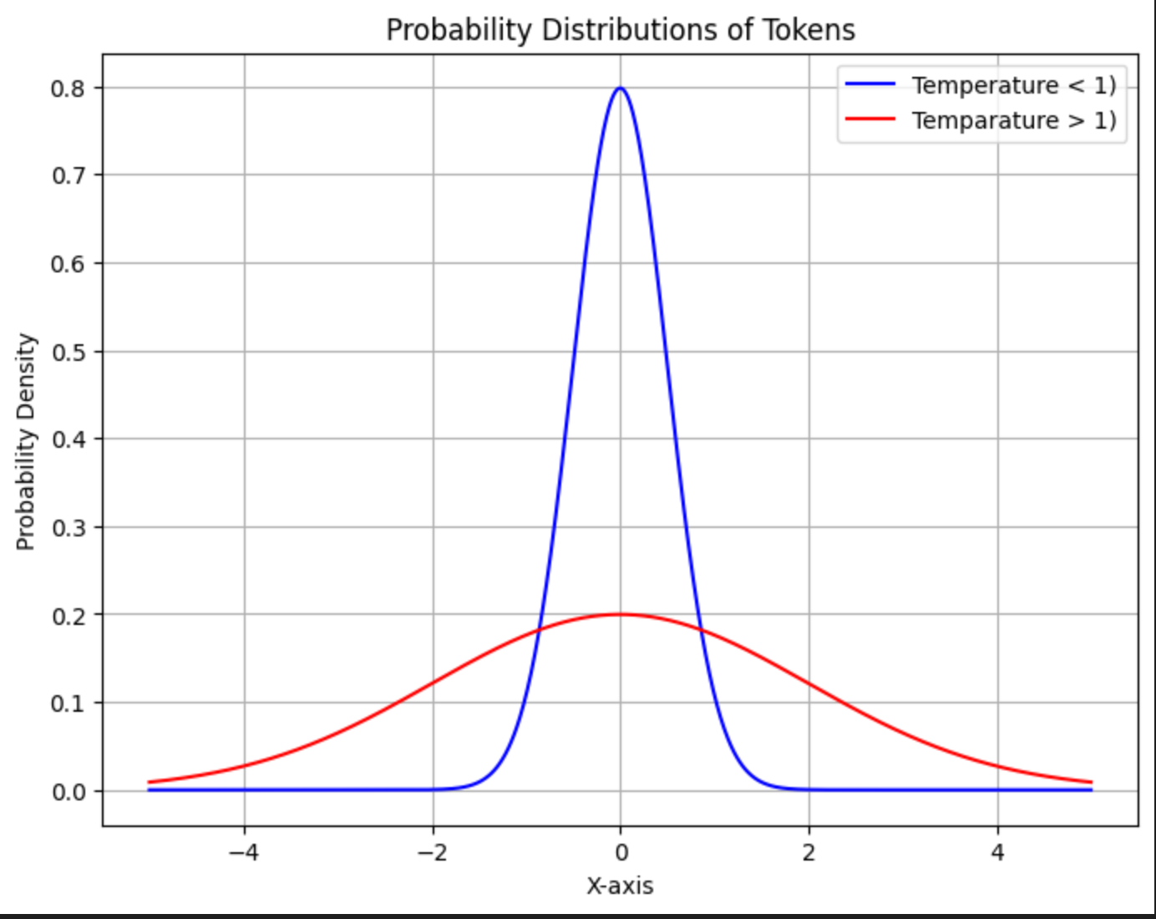
Parameters for Response Generation
k – value (Top-k sampling)
p – value (Top p sampling)
max_length (maximum number of output tokens)
num_beams (number of beams for beam search)
temperature (responsible for selection of output tokens)

Slide 13
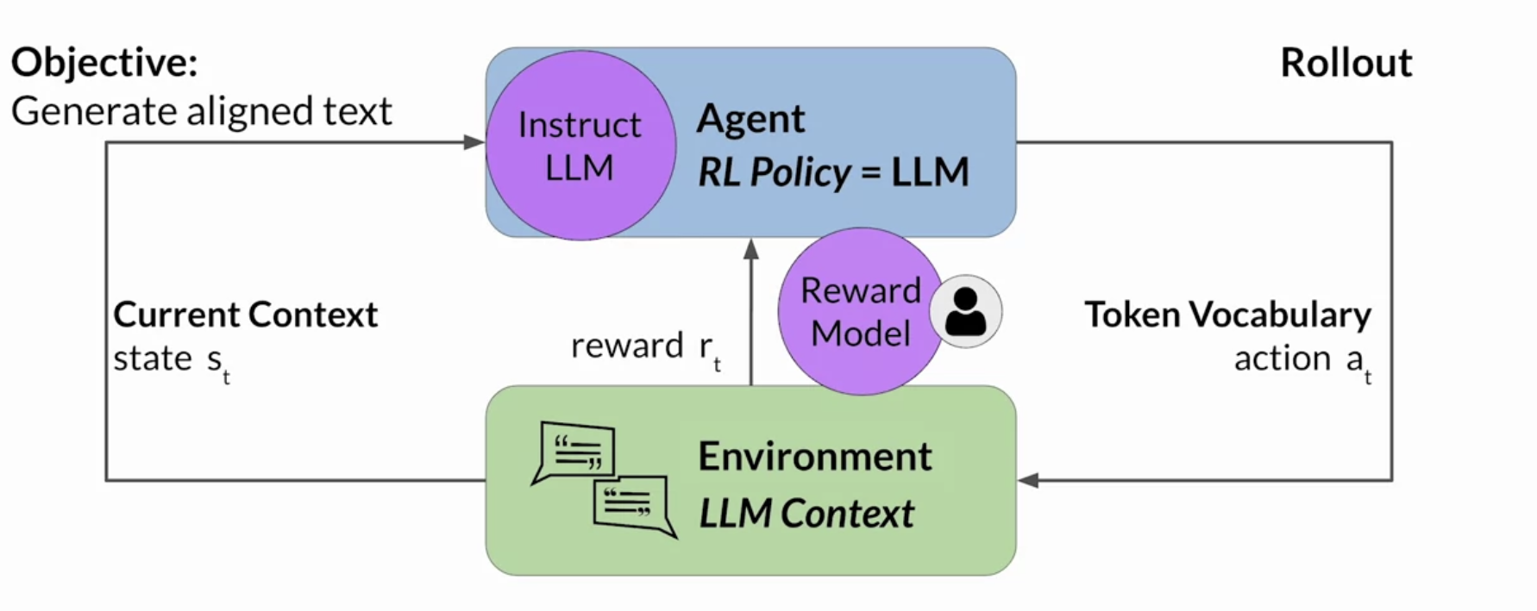
Reinforcement Learning
Reinforcement Learning (RL) is employed in this task primarily to obtain feedback and enhance the performance of the model
Reinforcement Learning with Cosine Similarity: using cosine similarity of embeddings as a reward function in the reinforcement learning model to encourage the generation of more contextually relevant responses
Credits: DeepLearning.AI

Slide 14
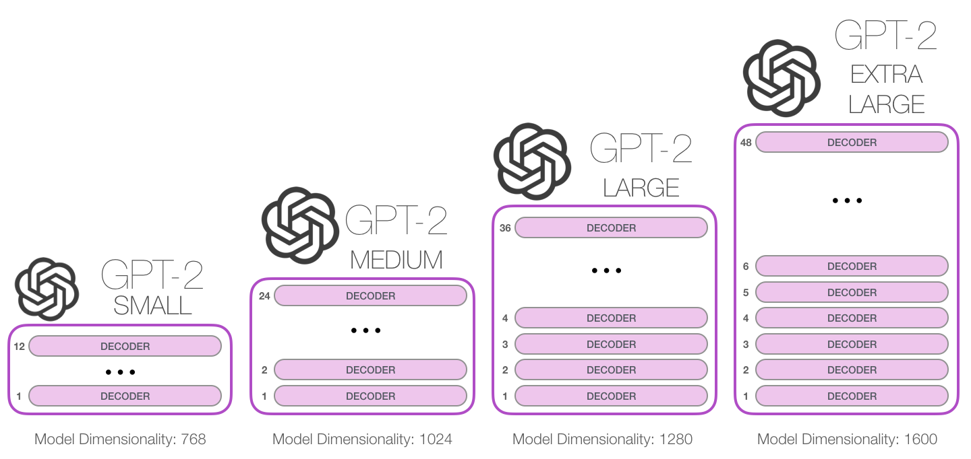
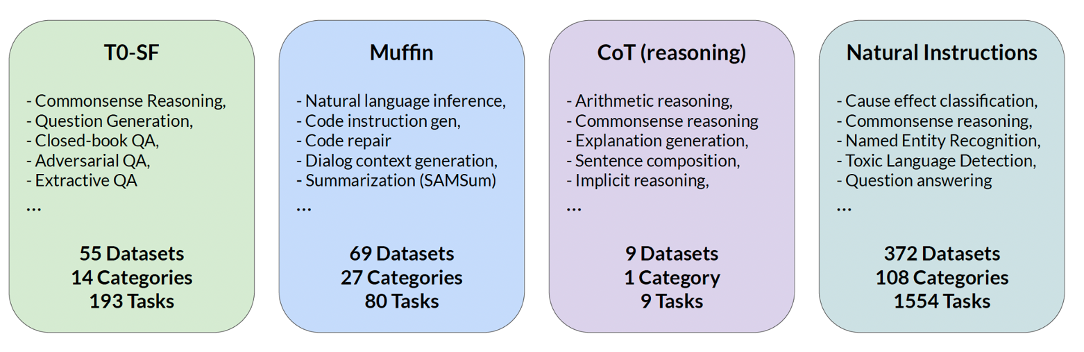
Large Language Models
FLAN – T5
Credits: DeepLearning.AI

Slide 15
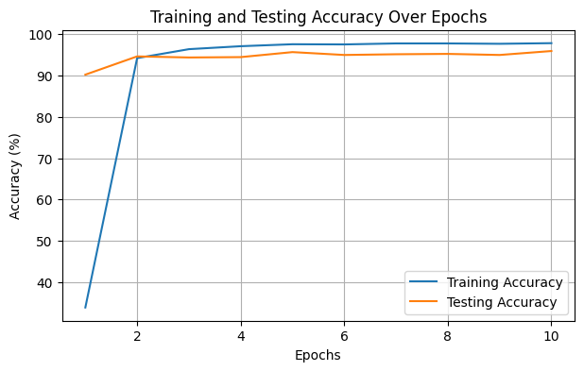
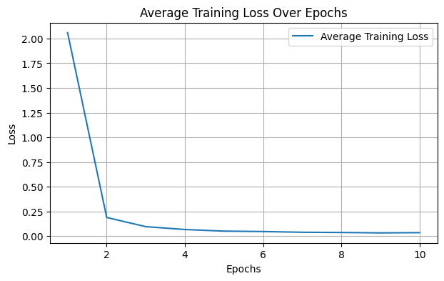
Results
1. Intent Classification
Models | Train Accuracy | Validation Accuracy
LSTM with Attention | 0.98 | 0.96
Bi-RNN | 0.95 | 0.92
Transformer | 0.96 | 0.95
Accuracy and Loss plots for LSTM with Attention

Slide 16
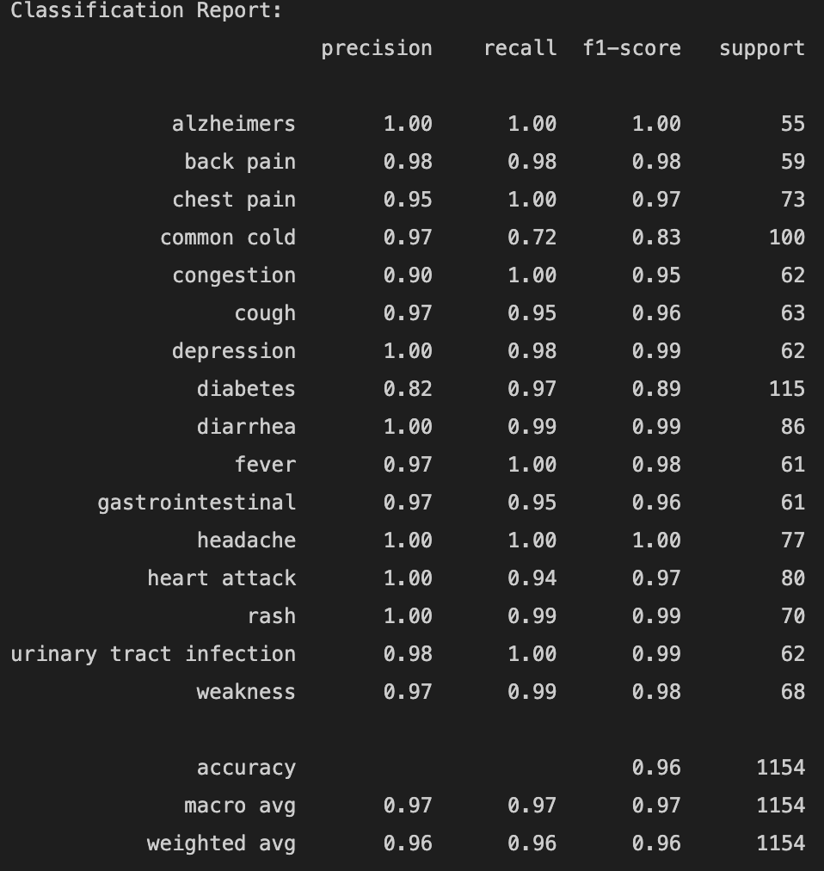
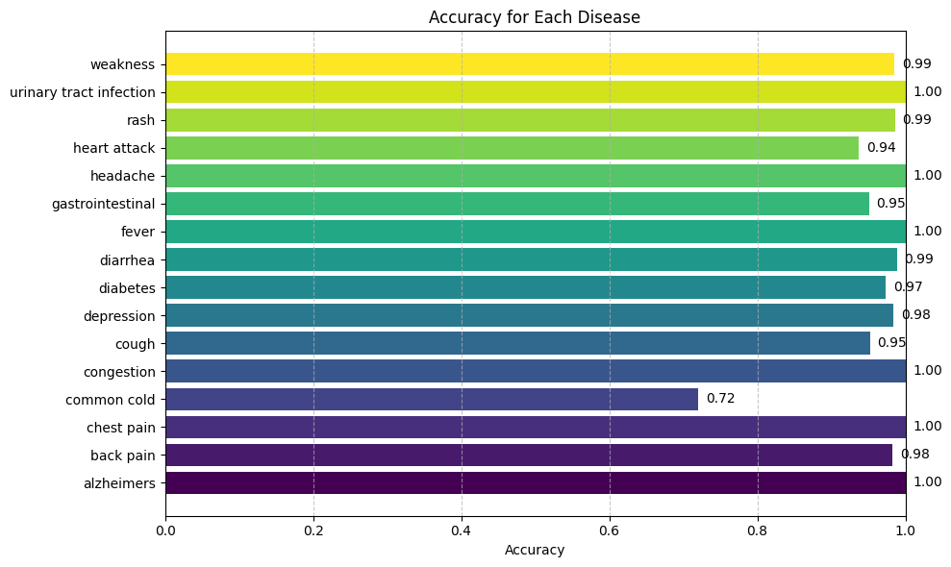

Slide 17
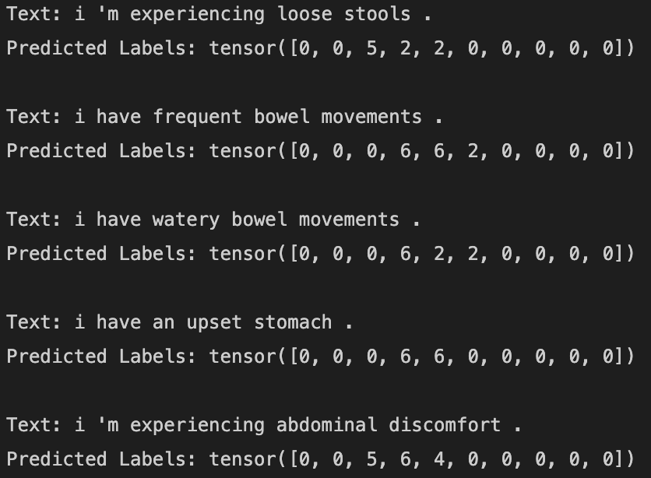
2. Named Entity Recognition
Detected the entities in queries with 98% accuracy and an F1 score of 0.84
Entities | Numerical Label
Miscellaneous (MISC) | 0
Medicine | 1
Symptom | 2
Disease | 3
Severity | 4
Sensation | 5
Body | 6
Entities used for NER
Detected Entity Results

Slide 18
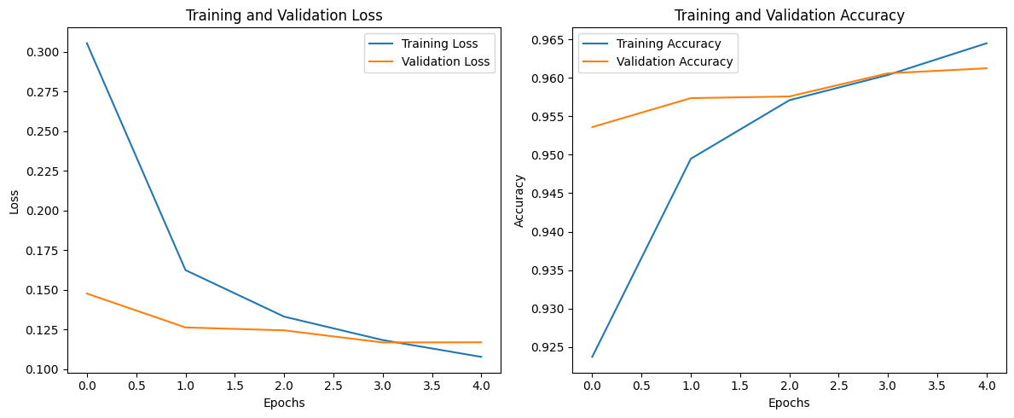
Accuracy and Loss plots for NER using BERT

Slide 19
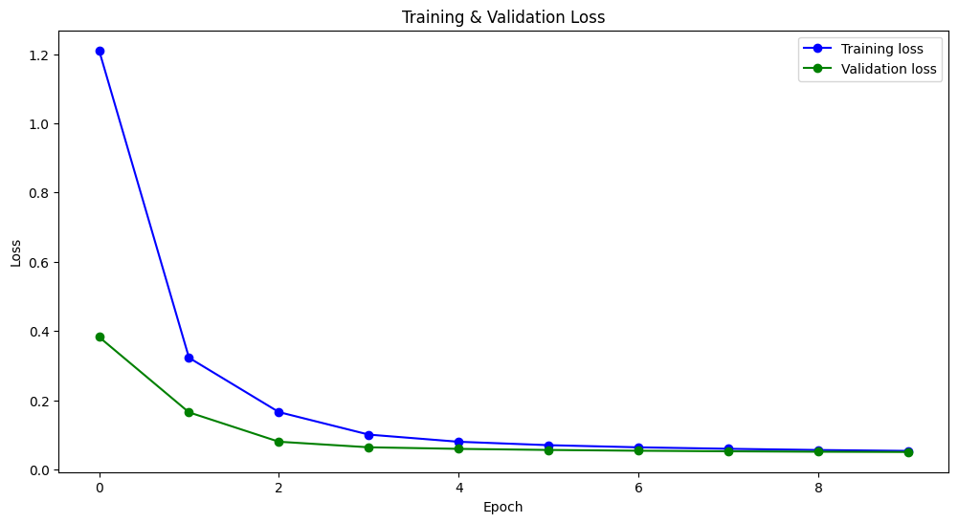
3. Contextual Understanding – Fine Tuning GPT2
Employed semantic similarity as a rigorous evaluation metric for response validation, achieved average semantic segmentation score of 0.7

Slide 20
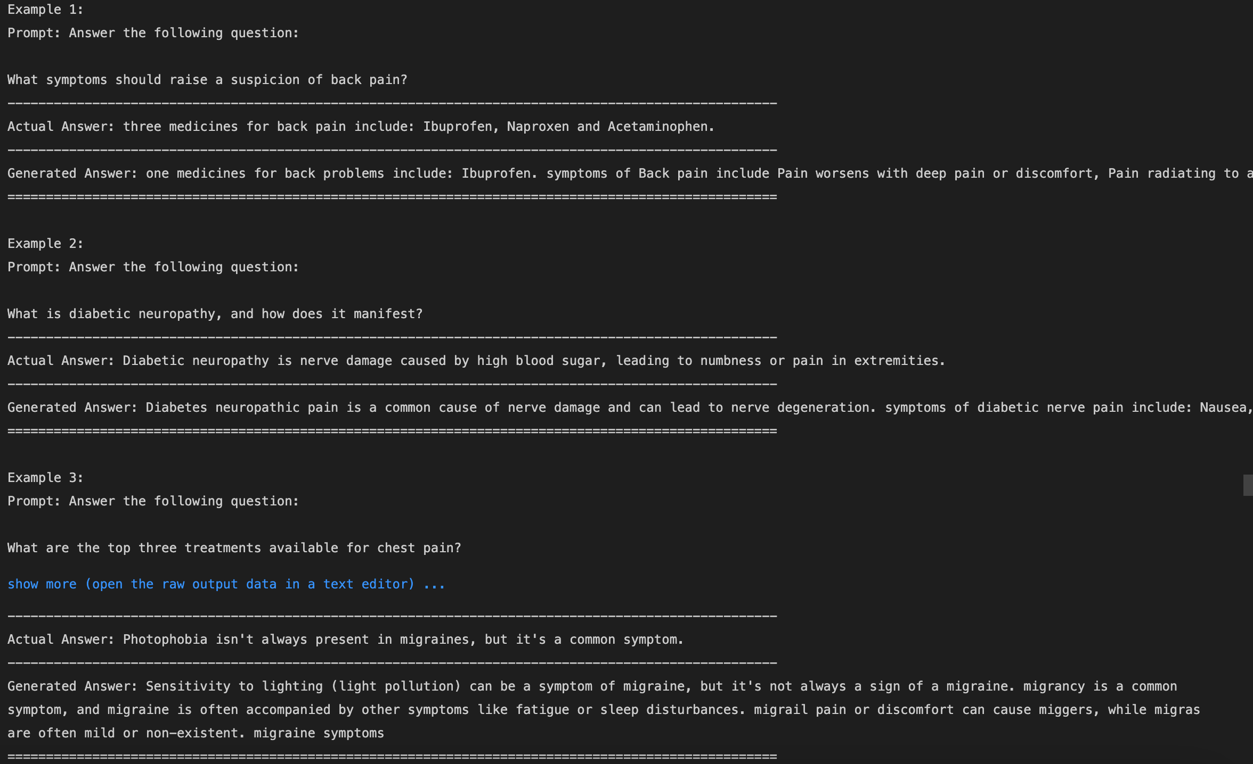
Health bot’s responses before reinforcement learning with GPT2

Slide 21
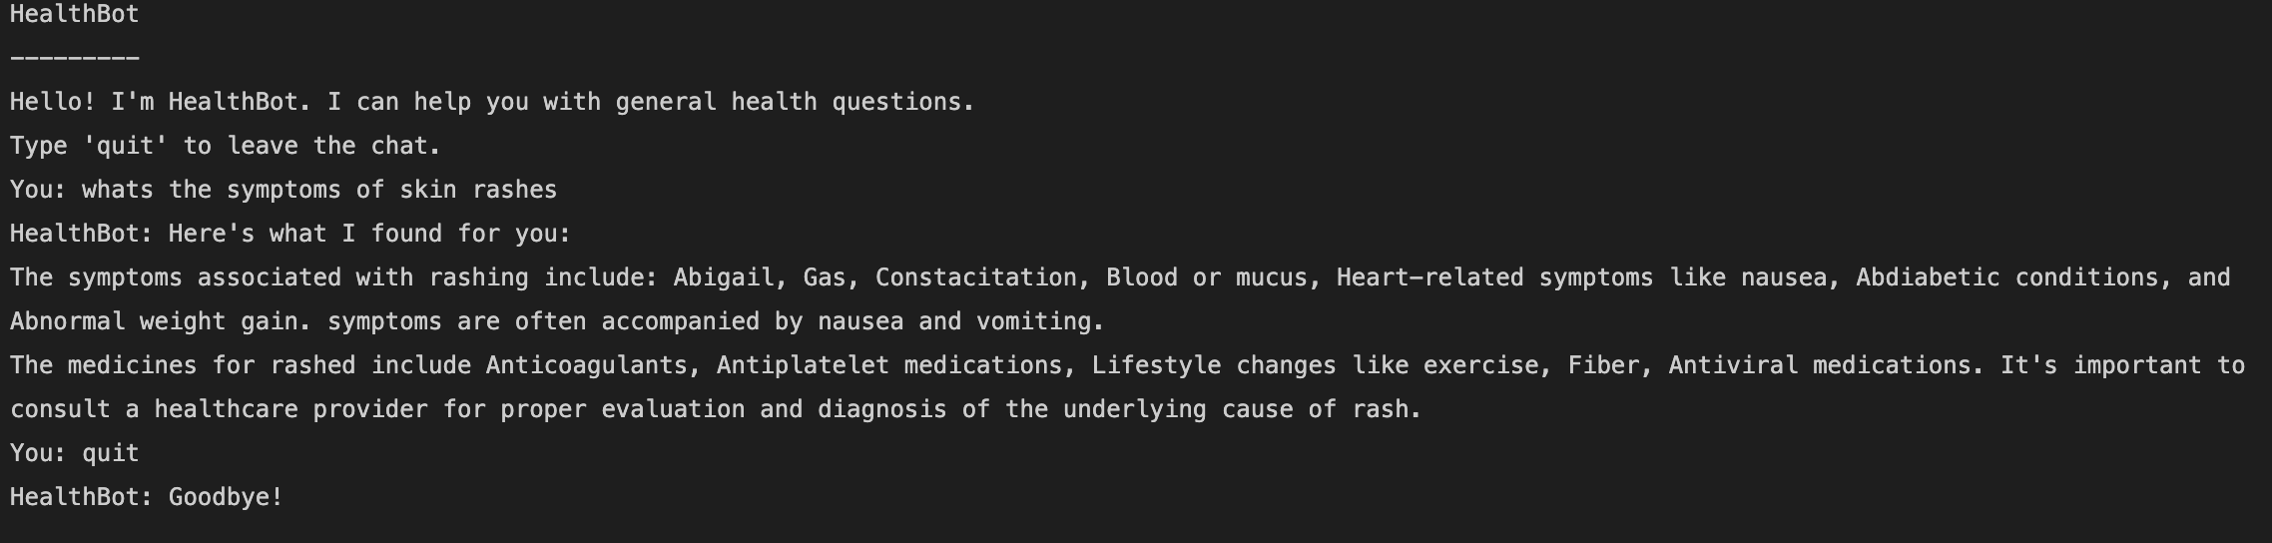
Final Healthbot response results for the input queries with GPT 2

Slide 22
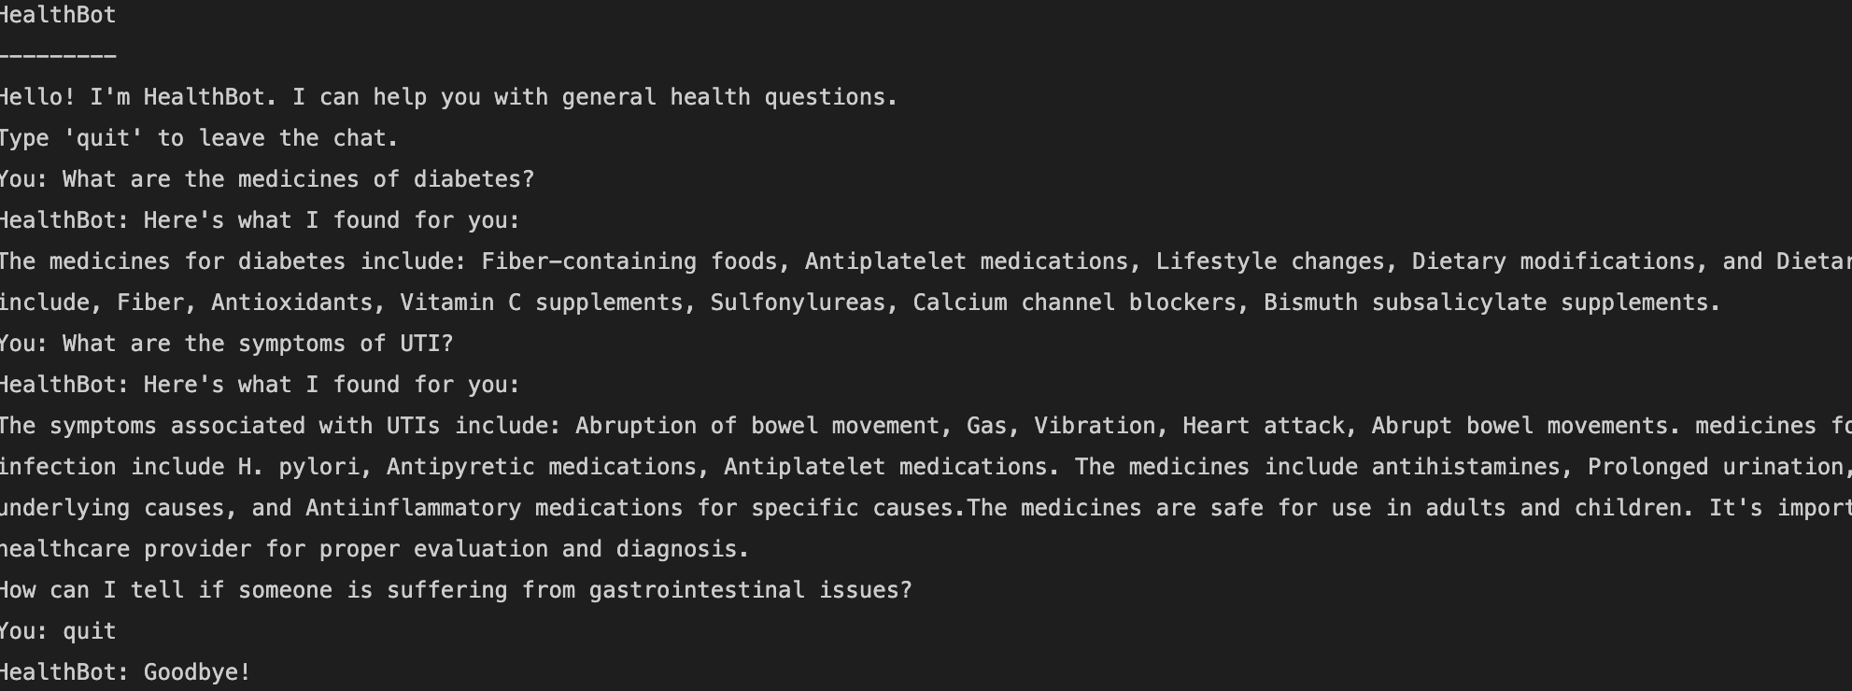
Final Healthbot response results with temperature = 2

Slide 23
Challenges
The complexity of capturing diverse user intents and ensuring the model's ability to discern subtle differences in queries.
Creating structured data templates for NER and Intent Classification tasks to ensure consistent and informative training data.
Incorporating natural language variations and colloquial expressions to make the model responses more user-friendly.
Managing the complexity of integrating multiple models for Named Entity Recognition (NER), Intent Classification, and large-scale language generation (GPT-2).
Lack of comprehensive and specialized health-related datasets from the internet.
Limited access to high-performance computing resources posed challenges in training and fine-tuning large language models like GPT-2.

Slide 24

Future Scope
Gather more data on a variety of diseases – Explore more Research Papers.
Explore the potential of deploying the health chatbot on cloud platforms like AWS for enhanced scalability and resource optimization.
Extend the chatbot's capabilities to support multiple languages, making healthcare information accessible to a more diverse user base – Incorporate an in-built translator.
Include more disease types
Extend the chatbot's capabilities to collaborate with AI solutions in other domains, such as nutrition, fitness, mental health, and lifestyle management, providing users with holistic well-being support.
Suggest help links, contact information, etc.

Slide 25

Future Scope
Thank you
Gather more data on a variety of diseases – Explore more Research Papers.
Explore the potential of deploying the health chatbot on cloud platforms like AWS for enhanced scalability and resource optimization.
Extend the chatbot's capabilities to support multiple languages, making healthcare information accessible to a more diverse user base – Incorporate an in-built translator.
Include more disease types
Extend the chatbot's capabilities to collaborate with AI solutions in other domains, such as nutrition, fitness, mental health, and lifestyle management, providing users with holistic well-being support.
Suggest help links, contact information, etc.

